Slide 1
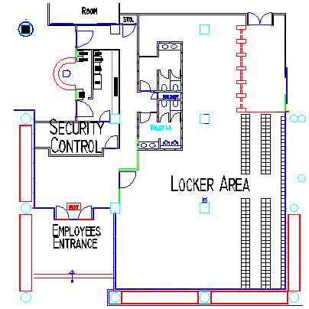
Building 2 Layout Temperature Taking

Slide 2
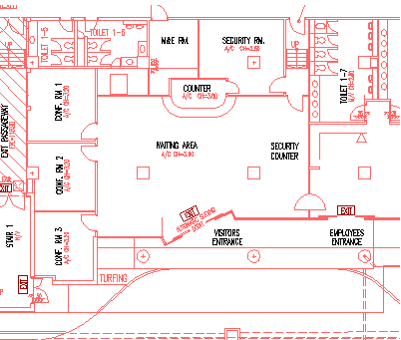
Building 3 Layout Temperature Taking

Slide 3
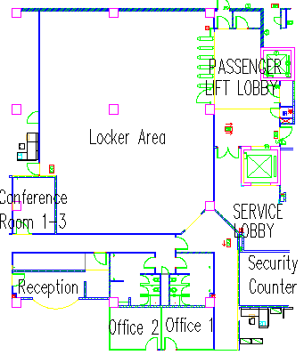
Building 6 Layout Temperature Taking

